Slide 1
Connecting PHP to files
Peter Blanchfield

Slide 2
What are we trying to do?
So far we have been talking about building our interface
We have a PHP interface to get user requests
We pass these requests on to the database
As SQL statements
We learned how to make a connection
Issue a request
Get back the results
An work through those requests

Slide 3
Some data may already exist in other ways
For example I have built up an Excel file of what I want in my database
New | Description | OLD
COMP4039 | Databases, Interfaces and Software Design Principles | G54DIS
COMP1004 | Databases and Interfaces | G51DBI
COMP2002 | Software Engineering Group Project | G52GRP
COMP4024 | Software Engineering Management | G54SPM
COMP3016 | Industrial Experience | G53IND

Slide 4
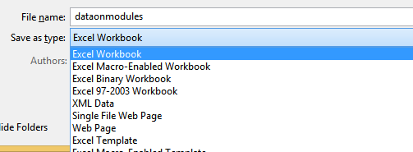
This is stored as a binary file
Excel files in their latest format
Are compressed files
A bit like PDF documents
However, Excel allows us to save the data in other formats

Slide 5
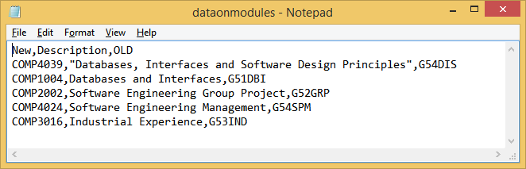
Text and CSV FIles
We can store them as plain text files
These can be formatted in various ways
CSV

Slide 6
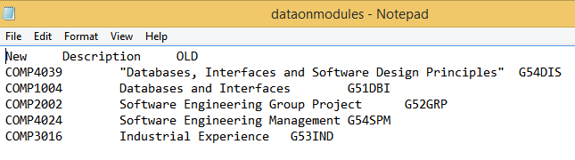
Text – Tab delimited

Slide 7
Reading files in PHP
There are simple classes for files in PHP
You can read and write to files
Here are two sets of simple code
The first reads a pre existing text file and writes it to the screen
The next creates a file first and then reads it and displays the contents

Slide 8
Reading
<html>
<body>
<h1>PHP Demo 9 - File i/o (reading)</h1>
<h2>poem.txt</h2>
<?php
$infile = fopen("poem.txt", "r") or die("Unable to open file!");
while(!feof($infile))
{
echo fgets($infile)."<br>";
}
fclose ($infile);
?>
</body>
</html>

Slide 9
What it does
It opens the file poem.txt for reading (“r”)
If the file can’t be opened it outputs an error message and stops
Otherwise it loops while (!feof($infile))
This means it stops at the end of the file (when feof($infile) will be true
And gets the contents and
Writes it to the screen

Slide 10
The writing example
<html>
<body>
<h1>PHP Demo 10 - File i/o (writing)</h1>
<h2><u>Creating output.txt</u></h2>
<?php
$outfile = fopen("output.txt", "w") or die("Unable to open file!");
fwrite($outfile, "A message from PHP\n");
fwrite($outfile, "Another line of text\n");
fclose ($infile);
echo "output.txt created...";
$infile = fopen("output.txt", "r") or die("Unable to open file!");
while(!feof($infile))
{
echo fgets($infile)."<br>";
}
fclose ($infile);
?>
</body>
</html>

Slide 11
This time
We open the file for writing “w”
Do a couple of writes
fwrite($outfile, "A message from PHP\n"); //for example
Then closes the file
fclose ($infile);
Before reading it again
If you didn’t close it you would not be able to open it again as a read file
So always Close files when you are finished with them

Slide 12
Dealing with delimited files
With delimited files
We want to break the read line up into parts
We can do this the hard way
Or the easy way

Slide 13
Reading a CSV – (also works for text tab delimited)
<html>
<head>
<title>The Likes of Fairytale Characters</title>
</head>
<body>
<?php
$file = fopen("lines.csv","r");
while($data = fgetcsv($file)){
echo "<p>";
echo $data[0] . " is " . $data[1] . " years old and likes " . $data[2];
echo "</p>";
}
fclose($file);
?>
</body>
</html>

Slide 14
This time we read the file as a CSV
$data = fgetcsv($file)
The PHP function fgetcsv has the format:
fgetcsv(<filehandle>, delimiter = ‘ , ’,length=1000);
Where <filehandle> is the file you want
Delimiter defaults to a comma but can be a tab for example
And expected length defaults to 1000 lines
$data will be an array
There are ways of getting this to recognise the header row
Then you can use it as an associative array

Slide 15
If there is time
I will try and use it in anger

